Slide 1

CRYPTOGRAPHY
Presented By : Prateek

Slide 2

What is Cryptography ?
Cryptography derived its name from a
Greek word called "Kryptos" which means "Hidden Secrets"
Cryptography is the practice and study of hiding information. It is the Art or Science of converting a plain intelligible data into an unintelligible data and again retransforming that message into its original form.
It provides
Confidentiality, Integrity, Accuracy.

Slide 3
What is Encryption/Decryption
Encryption -
﻿﻿ The process of converting plain text into an unintelligible format (cipher text) is called
Encryption.
﻿﻿Decryption -
﻿﻿The process of converting cipher text into a plain text is called Decryption.

Slide 4
What is a Key?
﻿In cryptography, a key is a variable value that is applied using an algorithm to a string or block of unencrypted text to produce encrypted text, or to decrypt encrypted text.
The length of the key is a factor in considering how difficult it will be to decrypt the text in a given message.
﻿﻿What is a Block Cipher?
﻿﻿A method of encrypting / decrypting data
﻿Key is used for encryption / decryption.
﻿
What is Initialization Vector?
﻿﻿An initialization vector (IV) is an arbitrary number that can be used along with a secret key for data encryption.
﻿It is a group of hex values.

Slide 5
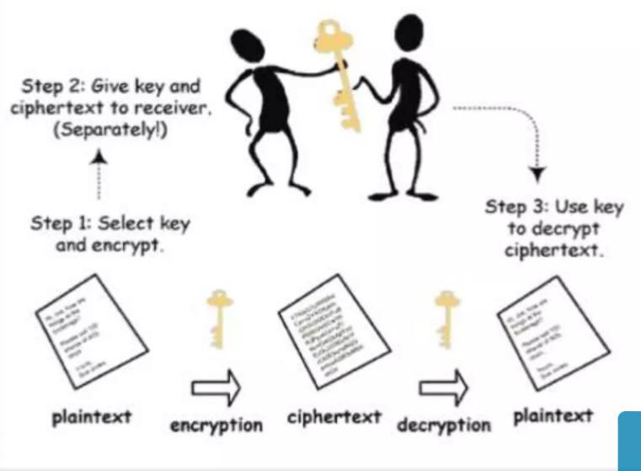
Symmetric Key Cryptography
(Secret Key Cryptography)
Same Key is used by both parties
Advantages
1. Simpler and Faster
Disadvantages
1. Less Secured

Slide 6
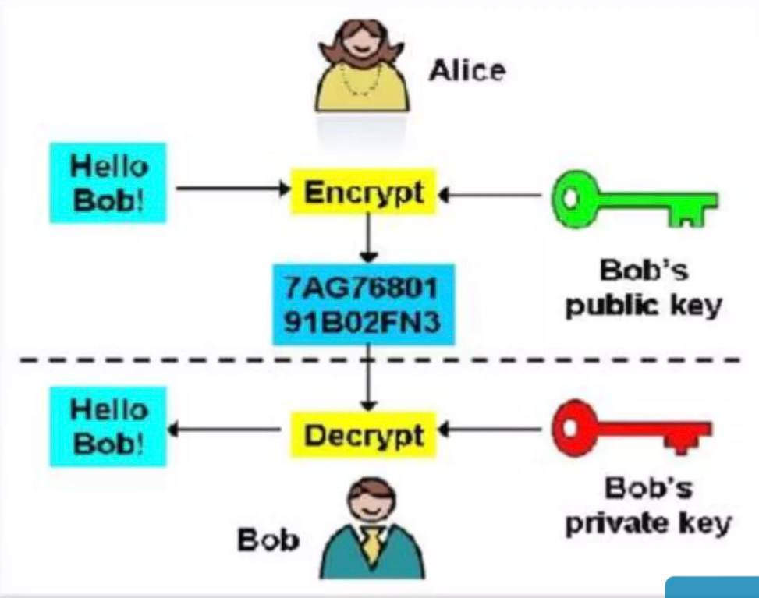
Asymmetric Key Cryptography (Public Key Cryptography)
2 different keys are used and
Users get the Key from an Certificate Authority
Advantages
﻿﻿﻿More Secured
﻿﻿﻿2. Authentication
Disadvantages
1. Relatively Complex

Slide 7
What is DES?
﻿﻿The Data Encryption Standard (DES) is a previously predominant algorithm used for encryption/decryption of electronic data. DES was developed in the early 70's by IBM which was then submitted to the National Bureau of Standards (NBS).
﻿﻿Like other private key cryptographic methods, both the sender and the receiver must know and use the same private key.
﻿﻿DES uses a 56 bit encryption key which can give around 2^56 (ie)
256 combinations to encrypt the plain text. DES is restricted with a Block Size of just 64bits.
Sometimes DES is said to use 64 bit key, but 8bits out of it is used for some other purpose.
﻿﻿The maximum amount that can be transferred with a single encryption is 32GB. DES uses the Feistel Network which divides, block into 2 halves before going through the encryption steps.

Slide 8
What is AES?
﻿The Advanced Encryption Standard (AES) is a specification for the Encryption of electronic data. Originally called "Rindael" the cipher was developed by 2 Belgian Cryptographers "Joan Daemen" and "Vincent Rimen“.
﻿
The algorithm described by AES is a Symmetric-Key Algorithm, meaning the same key is used for encrypting and decrypting the data. AES standard is a variant of Rijndael where the block size is restricted to 128bits and the key size of 128, 192, 256 bits can be used.
﻿
AES is based on a design principle known as a substitution-permutation network, and is fast in both software and hardware

Slide 9
Now our Next Topic is
RADIUS
(REMOTE AUTHENTICATION DIAL-IN USER SERVICE)

Slide 10
RADIUS
• REMOTE AUTHENTICATION DIAL-IN USER SERVICE
﻿﻿Developed for authentication and accounting by Livingston Enterprises in 1991
﻿﻿Bought by IETF.
WHY RADIUS?
﻿﻿Thousands of servers located which provide different services.
﻿﻿Different users access services provided by server.
﻿﻿Authentication required.
﻿﻿Authorization & Accounting also required
﻿﻿RADIUS provides AAA functionality

Slide 11
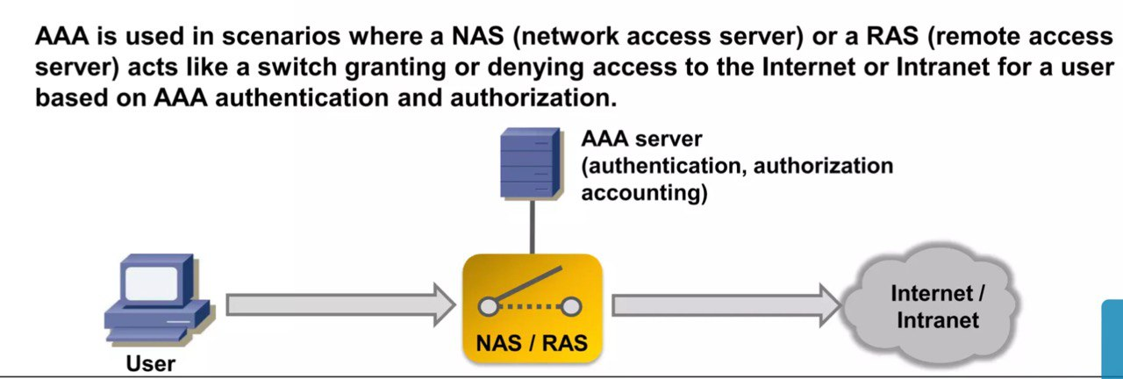
What is AAA ?
﻿﻿AAA stands for authentication, authorization and accounting.
﻿﻿Authentication : verify user
﻿﻿Authorization: services provided to the specific user
﻿﻿Accounting: billing for service used by the

Slide 12
FEATURES OF RADIUS
﻿Client/Server Model
﻿﻿Network Security
﻿﻿Flexible Authentication Mechanism
﻿﻿Extensible Protocol

Slide 13
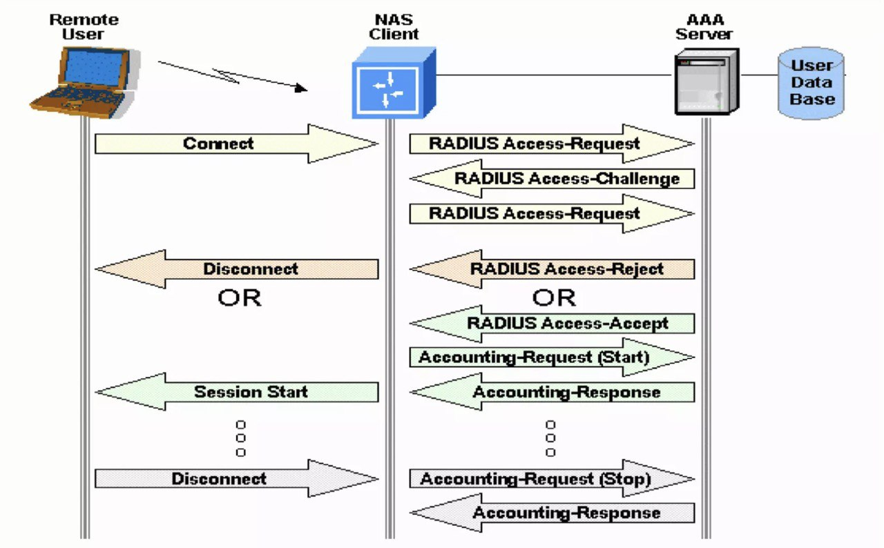
GENERAL FLOWGRAPH
FOR RADIUS

Slide 14
RADIUS DETAILS
RADIUS uses UDP and not TCP
Following are some reasons:
﻿﻿﻿1).User cannot wait for several minutes, so retransmission algorithm of TCP not required.
﻿﻿﻿2).No special handling for offline clients and Servers
﻿﻿﻿3).Stateless Protocol
﻿﻿﻿4).Easy to implement multi-threaded server and provide service to multiple

Slide 15
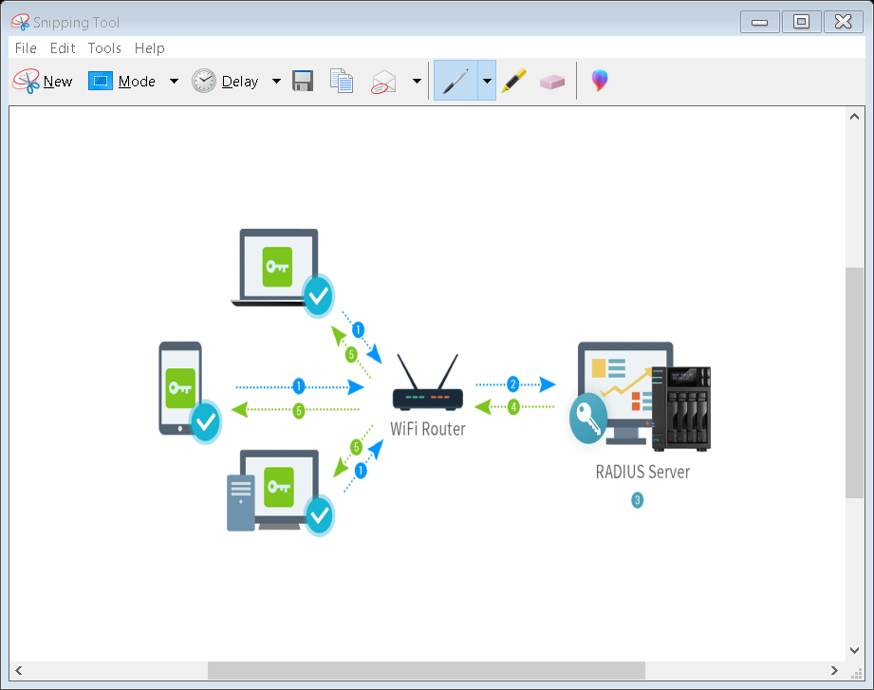

Slide 16
Connection Steps
1. User initiates PPP authentication to the NAS.
2. NAS prompts for username and password (if Password Authentication Protocol [PAP]) or challenge (if Challenge Handshake Authentication Protocol [CHAP]).
3. User replies.
4. RADIUS client sends username and encrypted password to the RADIUS server.
5. RADIUS server responds with Accept, Reject, or Challenge.
6. The RADIUS client acts upon services and services parameters bundled with Accept or Reject..

Slide 17
Remote Access Authentication Protocol
A remote access authentication protocol is the method by which remote users will be authenticated when they log on the network. One (unwise) choice is to allow users to log on without authentication.

Slide 18
There are simply two methods to authenticate PPP links namely Password Authentication Protocol (PAP) and Challenge Handshake Authentication Protocol (CHAP).
From these two authentication protocols, PAP is less secured as the password is sent in clear text and is performed only at the initial link establishment.

Slide 19
What is PAP ?
PAP is a password Authentication Protocol used by PPP links to validate users. PAP authentication requires the calling device to enter the username and password. If the credentials match with the local database of the called device or in the remote AAA database then it is allowed to access otherwise denied
Features of PAP Some of the features of PAP are:
• The password is sent in clear text.
• All network operating system support PAP.
• It uses two-way Handshake Protocol.
• It is non-interactive.
• PAP supports both one-way authentication (unidirectional) and two-way authentication (bidirectional)

Slide 20
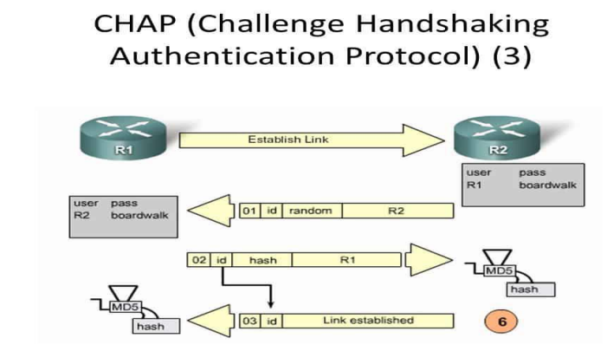
CHAP
Challenge Handshake Authentication Protocol (CHAP) is a Point-to-point protocol (PPP) authentication protocol developed by IETF (Internet Engineering Task Force). It is used at the initial startup of the link. Also, it performs periodic checkups to check if the router is still communicating with the same host.

Slide 21
Features of CHAP
• It uses 3-way handshaking protocol (not like TCP). First, the authenticator sends a challenge packet to the peer then, the peer responds with a value using its one way hash function. The authenticator then matches the received value with its own calculated hash value. If the values match then the authentication is acknowledged otherwise, the connection will be terminated.
• It uses one-way hash function called MD5.
• It also authenticates periodically to check if the communication is taking place with the same device or not.
• Also, it provides more security than PAP (Password Authentication Procedure) as the value used (find out by hash function) is changed variably.
• CHAP requires to know the plaintext of the secret as it is never sent over the network.

Slide 22
CHAP Packets
There are 4 types of CHAP packets
1).Challenge Packet
2).Response Packet
3).Success Packet
4).Failure Packet

Slide 23
When to use PAP
PAP is usually used in following scenarios:
• When the application doesn’t support CHAP.
• Circumstances where it is necessary to sent a plain text password to stimulate a login at the called device (remote host).
• When there is occurrence of incompatibilities between different vendors of CHAP.

Slide 24
Advantage of CHAP over PAP Some of the advantages are:
• CHAP is more secured than PAP.
• CHAP can provide authentication periodically to recognise that the user accessing the PPP link is same or not.
• In CHAP, the real passwords are never shared on the link instead a hash value of it is calculated and transferred.
Advantage of PAP over CHAP
The only advantage PAP holds over CHAP is that it is supported by the all the network operating system vendors therefore it can be said that PAP is used where CHAP is not supported. But if CHAP is supported then it is recommended to use CHAP as it is more secured.

Slide 25
THANK YOU

